Slide 1

CAPSTONE 2 A/B TESTING!!!
BY: Philip Stewart Jr.

Slide 2

My first assumptions

Slide 3
H_{o}: p₁ - p₂ = 0 Hₐ: p₁ - p₂ ≠ 0
My test results shows my confidence level is .60 so I the reject null. My p-value result is 0 city vs Highway MPG.

Slide 4

My second Assumptions

Slide 5
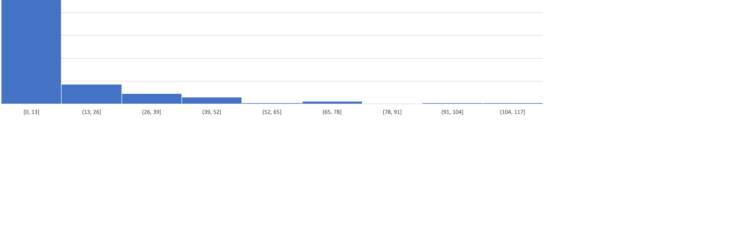
My hypothesis is 2D has a bigger volume than 4D volume I reject the null because the test results gave a p-value below the confidence level and it proves that there is a skew in the graph.

Slide 6
My Last Assumptions

Slide 7
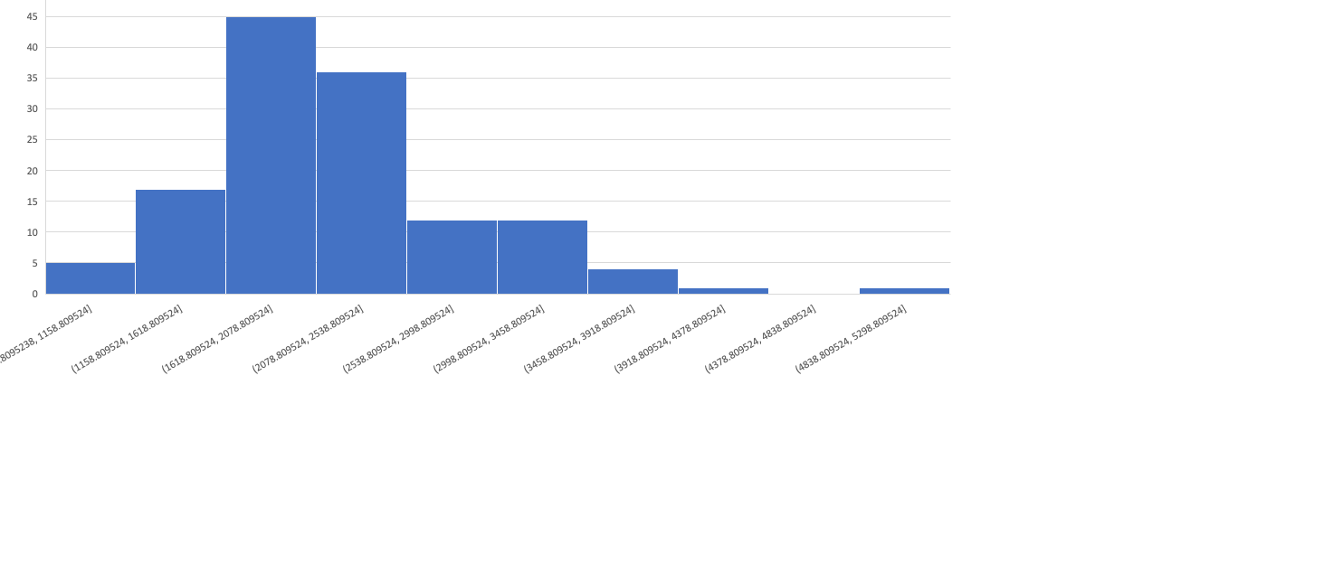
My hypothesis is Annual cost vs city MPG. As my results show I reject the null because the p-value is above the confidence level

Slide 8
In Conclusion
As you can see I performed my hypothesis on the Data concerning the fuel economy.
I came up with the results that I’ve shown forth in this presentation.

